Slide 1




GUIDED BY,
G. SHANTHI M.C.A., M.Tech.
HOD of Computer Application
KCAS
PRESENTED BY,
Mansa Iyer Meena.G Meena.P Monisha.S Monisha.V
BCA III Year

Slide 2

The BMI Web Application is a simple and effective tool designed to calculate Body Mass Index (BMI) based on user-provided height and weight. It categorizes BMI into classifications such as underweight, normal weight, overweight, and obese, enabling users to assess their health status. The tool promotes health awareness and weight management by providing instant results and basic health tips. This lightweight and accessible application is ideal for individuals who wish to monitor their BMI regularly and maintain a healthy lifestyle.
KEYWORDS
BMI Calculation, Web Application, Health Monitoring, Body Mass Index, Responsive UI, Weight Management, Fitness Tracker, User-Friendly Interface, Health Awareness

Slide 3

In today's world, health awareness plays a vital role in everyone's life. One of the widely used methods to assess whether an individual has a healthy body weight is by calculating Body Mass Index (BMI). BMI is a simple metric that evaluates body weight relative to height, helping to categorize individuals into different health categories such as underweight, normal weight, overweight, or obese.
This application not only calculates BMI but also offers personalized weekly diet plans based on the user's weight category in Vegan, Vegetarian, and Non-Vegetarian options. It includes Exercise Tutorials in both Video and Textual formats to guide users in maintaining a healthy lifestyle. Additionally, a Feedback System is provided where users can share their opinions, which can be accessed only by the admin through password-protected authentication.

Slide 4
To ensure smooth functionality and performance of the BMI Fitness Web Application, the following hardware requirements are recommended:
Processor: Intel Core i3 12th Generation or higher
RAM: 8GB
Storage: 512GB SSD
Display: 15.6’’ FHD Screen
OS: Windows 11
Browser: Google Chrome (Latest Version) or other
Pre-installed Software: MS Office 2021

Slide 5
The BMI Fitness Web Application is developed using the following software tools :
Visual Studio Code(VS Code): Latest Version
VS Code Extensions: Prettier
Web Browser Used: Google Chrome

Slide 6
Popular fitness platforms like Fitbit offer BMI calculations and fitness guidance. However, these platforms often require registration, subscriptions, or paid memberships to access premium features.
Additionally, most applications focus solely on BMI calculations without comparing body fat percentage, which limits their accuracy in categorizing users' health conditions.

Slide 7

Lack of body fat percentage comparison with BMI
Paid access to diet and exercise plans
Limited personalized diet options (vegan, vegetarian, non-vegetarian)
Absence of a feedback system to evaluate user satisfaction
Subscription-based access to premium resources.

Slide 8
The proposed BMI Fitness Web Application aims to overcome these limitations with the following features:
BMI calculation based on Age, Weight, Height, and Gender, with categorization by comparing both BMI and Body Fat Percentage.
Weekly Diet Plans for Underweight, Normal weight, and Overweight users in Vegan, Vegetarian, and Non- Vegetarian options.
Exercise Tutorials in both Video and Textual formats for
Cardio, HIIT, and Strength Training.
Feedback Form to collect user opinions, which can only be accessed by the admin using an authenticated password system.
Completely Free Access without any subscription or registration.

Slide 9
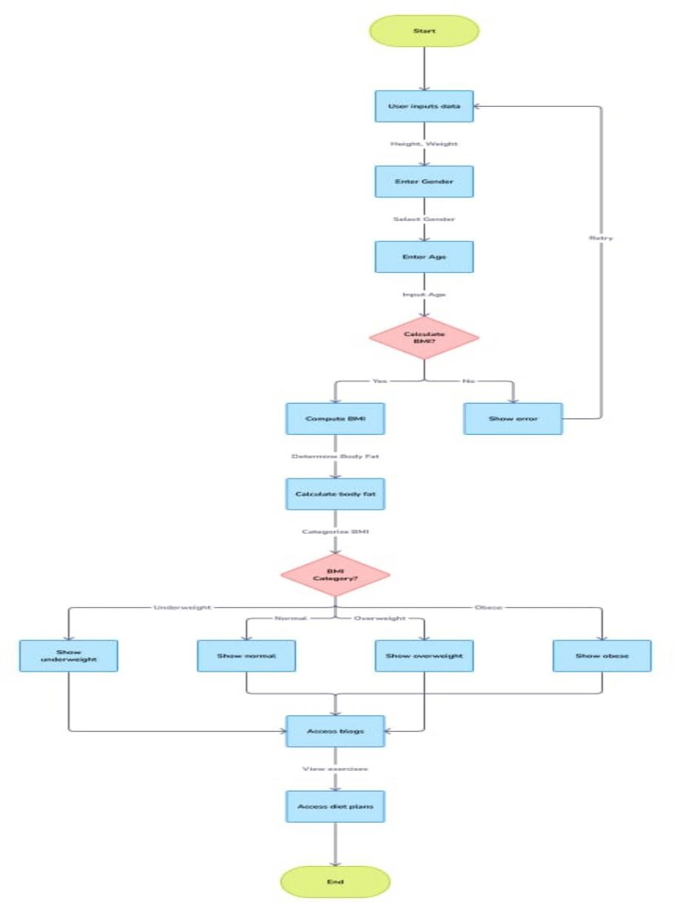

Slide 10
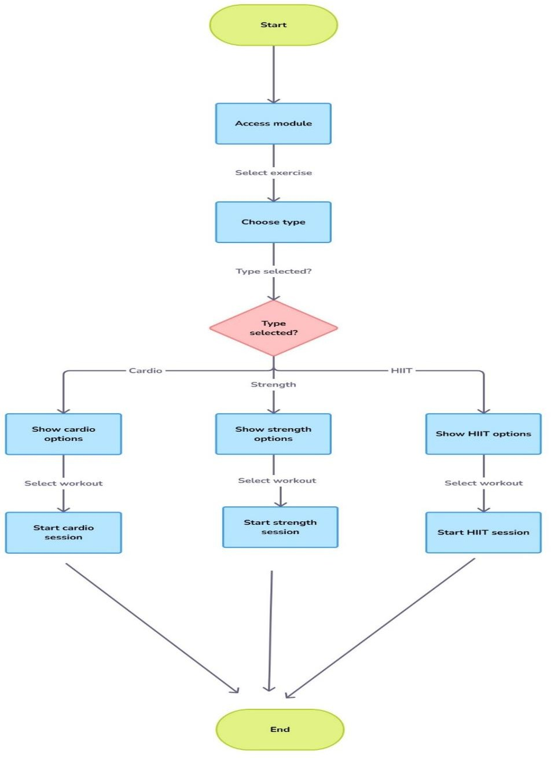

Slide 11
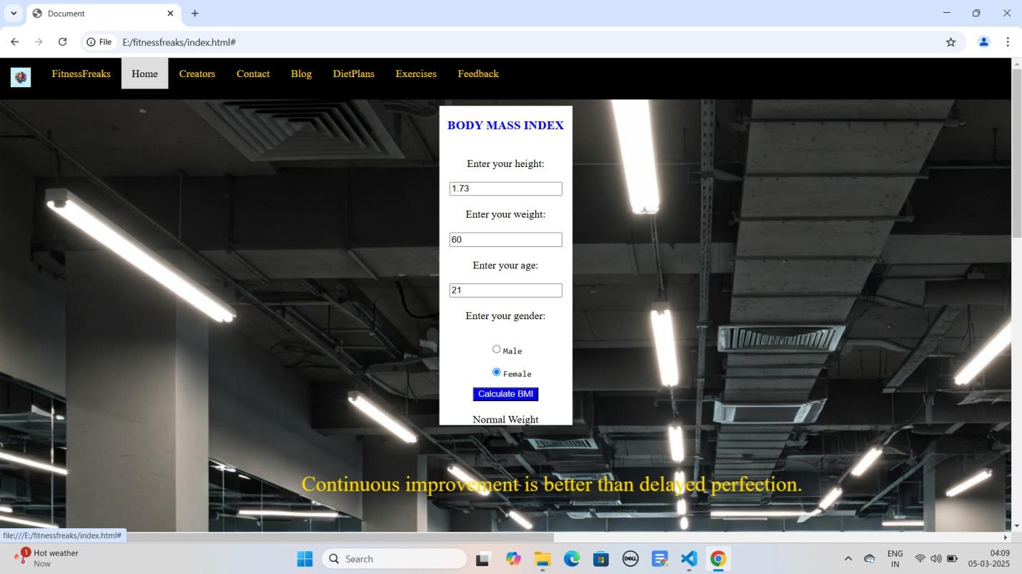
List of Modules
Home
Creators and Contact
Blog
Diet Plan
Exercises
Feedback

Slide 12
HOME
The Home page serves as the main interface of the BMI Web Application. It provides users with an input form to enter their height and weight for instant BMI calculation. The result is displayed with a color-coded category (underweight, normal, overweight, or obese) and a brief health tip. The page is designed with a clean, responsive layout to ensure a smooth user experience across different devices
CREATORS AND CONTACT
The Creator page gives credit to the developer(s) behind the BMI Web Application. It includes details about the creator’s name, background, and motivation for building the application. Additionally, this page may feature links to the creator’s portfolio.We provide a phone number and mail ID for contact

Slide 13
BLOG
The Blog section contains articles and informative content related to BMI, health, fitness, and wellness. Topics may include how BMI is calculated, its importance, common misconceptions, and tips for maintaining a healthy lifestyle. This section helps users stay informed about health and fitness trends while encouraging regular engagement with the application.
DIET PLAN
The Diet Plan page provides personalized dietary recommendations based on the user's BMI category. It includes:
Underweight: High-calorie, nutrient-rich foods for healthy weight
gain.
Normal weight: Balanced meal plans for maintaining a healthy lifestyle.
Overweight & Obese: Low-calorie, high-fiber diets with portion control tips.

Slide 14
EXERCISES
The Exercises page offers fitness recommendations based on BMI results. It includes:
Underweight: Strength training and resistance exercises for
muscle gain.
Normal weight: A balanced mix of cardio, strength, and flexibility workouts.
Overweight & Obese: Low-impact exercises like walking, swimming, and beginner-friendly workouts to reduce weight safely.
FEEDBACK
This page gathers user feedback on how this application was useful for them and these data will be accessed only by admin using password that is not known to the user.This really enable us to upload new features to the application to make it more efficient as it plays a key role for the progress of every application.

Slide 16
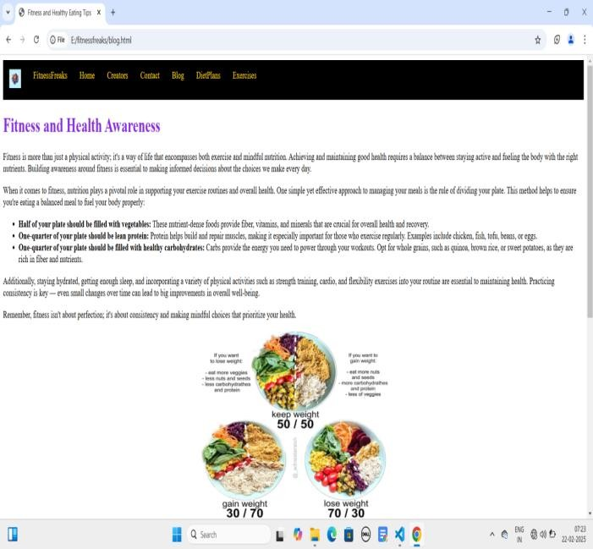

Slide 17
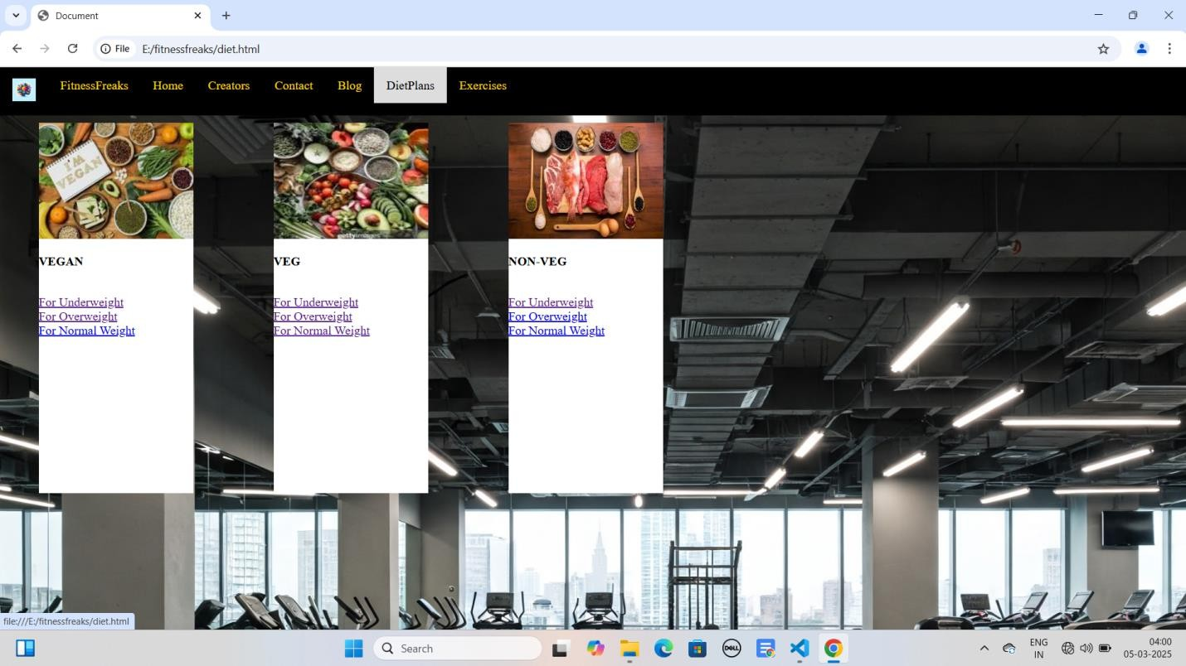

Slide 18
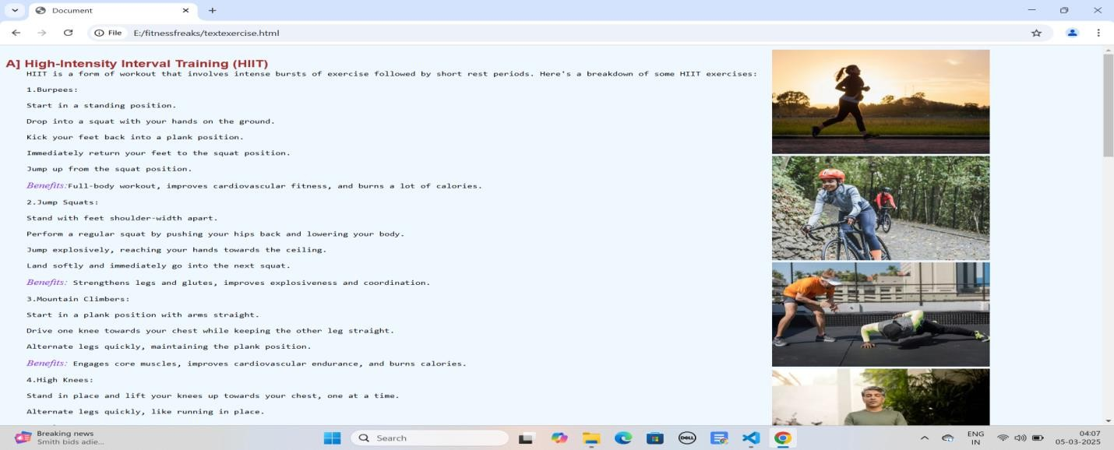

Slide 19

The BMI Web Application is a simple yet powerful tool for assessing body mass and promoting health awareness. Using HTML, CSS, and JavaScript, it offers a user-friendly experience with instant BMI calculations and easy-to-understand health classifications. This lightweight and responsive web application is suitable for anyone interested in monitoring their weight and improving their health. By delivering real-time feedback, users can gain valuable insights into their current health status and make informed decisions about their fitness journey.

Slide 20

Web Development Technologies:
W3Schools. (2025). HTML, CSS, and JavaScript Tutorials. Retrieved from https://www.w3schools.com
Mozilla Developer Network (MDN). (2025). HTML, CSS, and JavaScript Documentation. Retrieved from https://developer.mozilla.org
BMI Calculation and Health Information:
World Health Organization (WHO). (2025). Body Mass Index (BMI) Classification. Retrieved from https://www.who.int
Diet and Nutrition Guidelines:
Medical News Today. (2025). Balanced Diet for Vegan, Vegetarian, and Non-Vegetarian Diets. Retrieved from https://www.medicalnewstoday.com
Exercise and Fitness Programs:
Verywell Fit. (2025). Beginner Cardio and Strength Training Exercises. Retrieved from https://www.verywellfit.com
YouTube Fitness Channels (2025). Video Tutorials for Home Workouts.

Slide 21
Thank you

